Slide 1
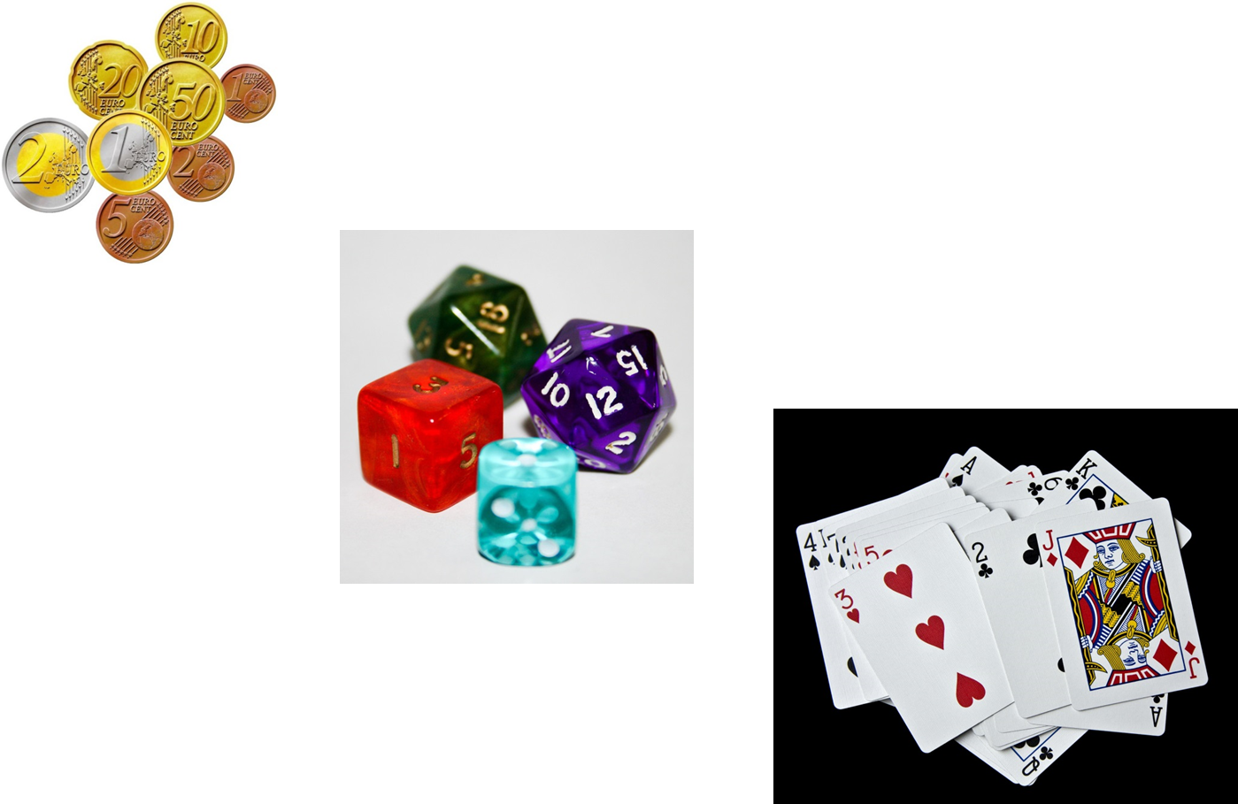
Topic: Probability
EQ: How do we find the probability of events?
Start: Do times tables grid!

Slide 2
Warm Up - BINGO
Do a 3 x 3 grid
Two dice will be rolled and values added – choose 9 numbers for your grid
What is the lowest and the highest numbers possible?
You can have multiple of one number, you can only cross one off each time it is rolled
Did it take lots of rolls for someone to win?
Were there some numbers that rolled more than others?

Slide 3
BINGO
This is the outcome table for the experiment
What numbers have a higher probability of being rolled?
Let’s play another game – does this table change what numbers you choose?
Dice One
+ | 1 | 2 | 3 | 4 | 5 | 6
1 | 2 | 3 | 4 | 5 | 6 | 7
2 | 3 | 4 | 5 | 6 | 7 | 8
3 | 4 | 5 | 6 | 7 | 8 | 9
4 | 5 | 6 | 7 | 8 | 9 | 10
5 | 6 | 7 | 8 | 9 | 10 | 11
6 | 7 | 8 | 9 | 10 | 11 | 12
Dice Two
36 possible outcomes

Slide 4
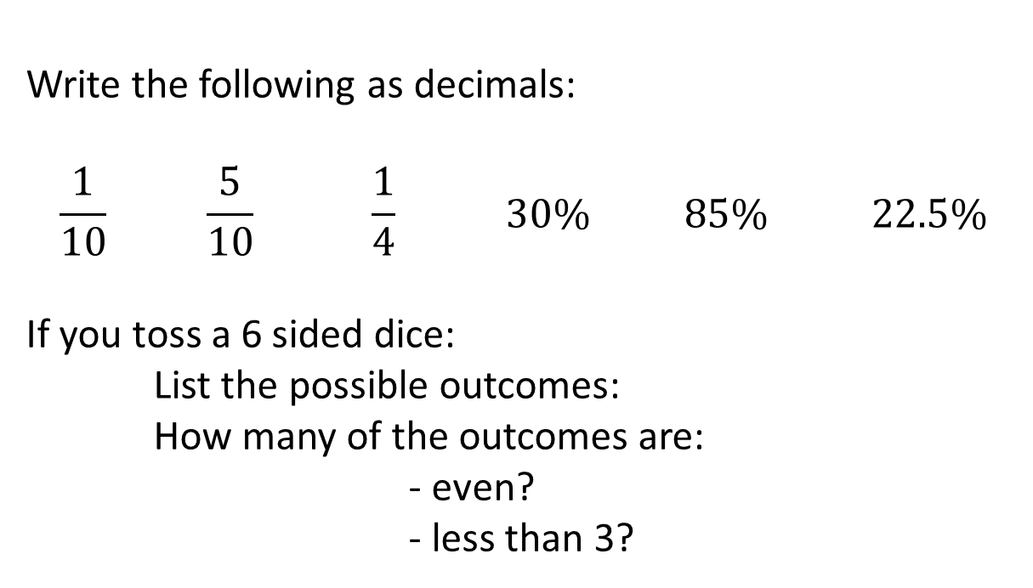
Topic: Probability
EQ: How do we find probabilities of events?
Write the following as decimals:
$$\frac{1}{10} \frac{5}{10} \frac{1}{4} 30\% 85\% 22.5\%$$
If you toss a 6 sided dice:
List the possible outcomes:
How many of the outcomes are:
- even?
- less than 3?

Slide 5
Probability
Tells the chance that something will happen.

Slide 6
We use the words probability and chance to mean the same thing.
We hear and make statements that involve probability all the time.
What are some of the words we use?

Slide 7


Slide 8
Outcomes
Possible results of a probability experiment

Slide 9
Sample Space
A Sample Space is a complete list of all possible outcomes.
For example: Tossing a coin: There are two possibilities: head or Tail. The Sample Space is: S = {H, T}

Slide 10



The Sample Space for spinning the spinner.
^{S = {Green, Blue, Red, Yellow}}
The Sample Space for throwing a die.
S = {1,2,3,4,5,6}
The Sample Space for tossing a coin.
S = {H,T}

Slide 11
Event
Collection of outcomes from an experiment

Slide 12
Predictions
When you use the probability of an event to make an educated guess.

Slide 13

Theoretical Probability—
The probability of an event is the number of favorable outcomes divided by the number of possible outcomes.

Slide 14
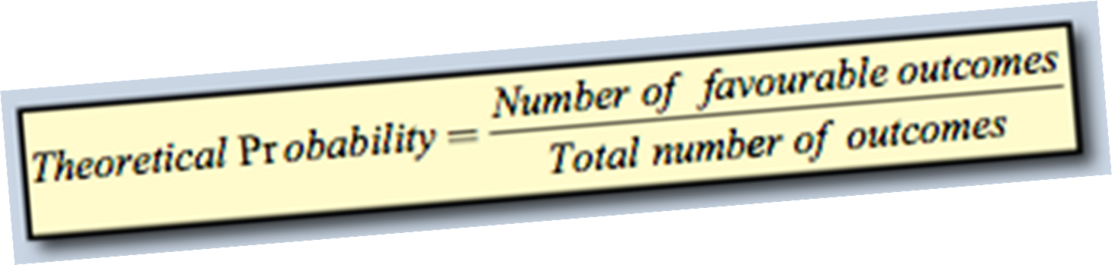
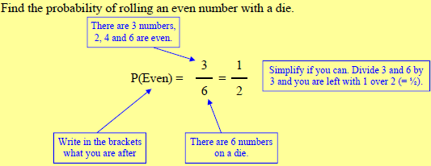

Slide 15
Experimental Probability—
The probability of an event is the number of times an event occurs divided by the total number of trials.
Experimental Probability = $\frac{number of times event occurs}{total number of trials}$

Slide 16
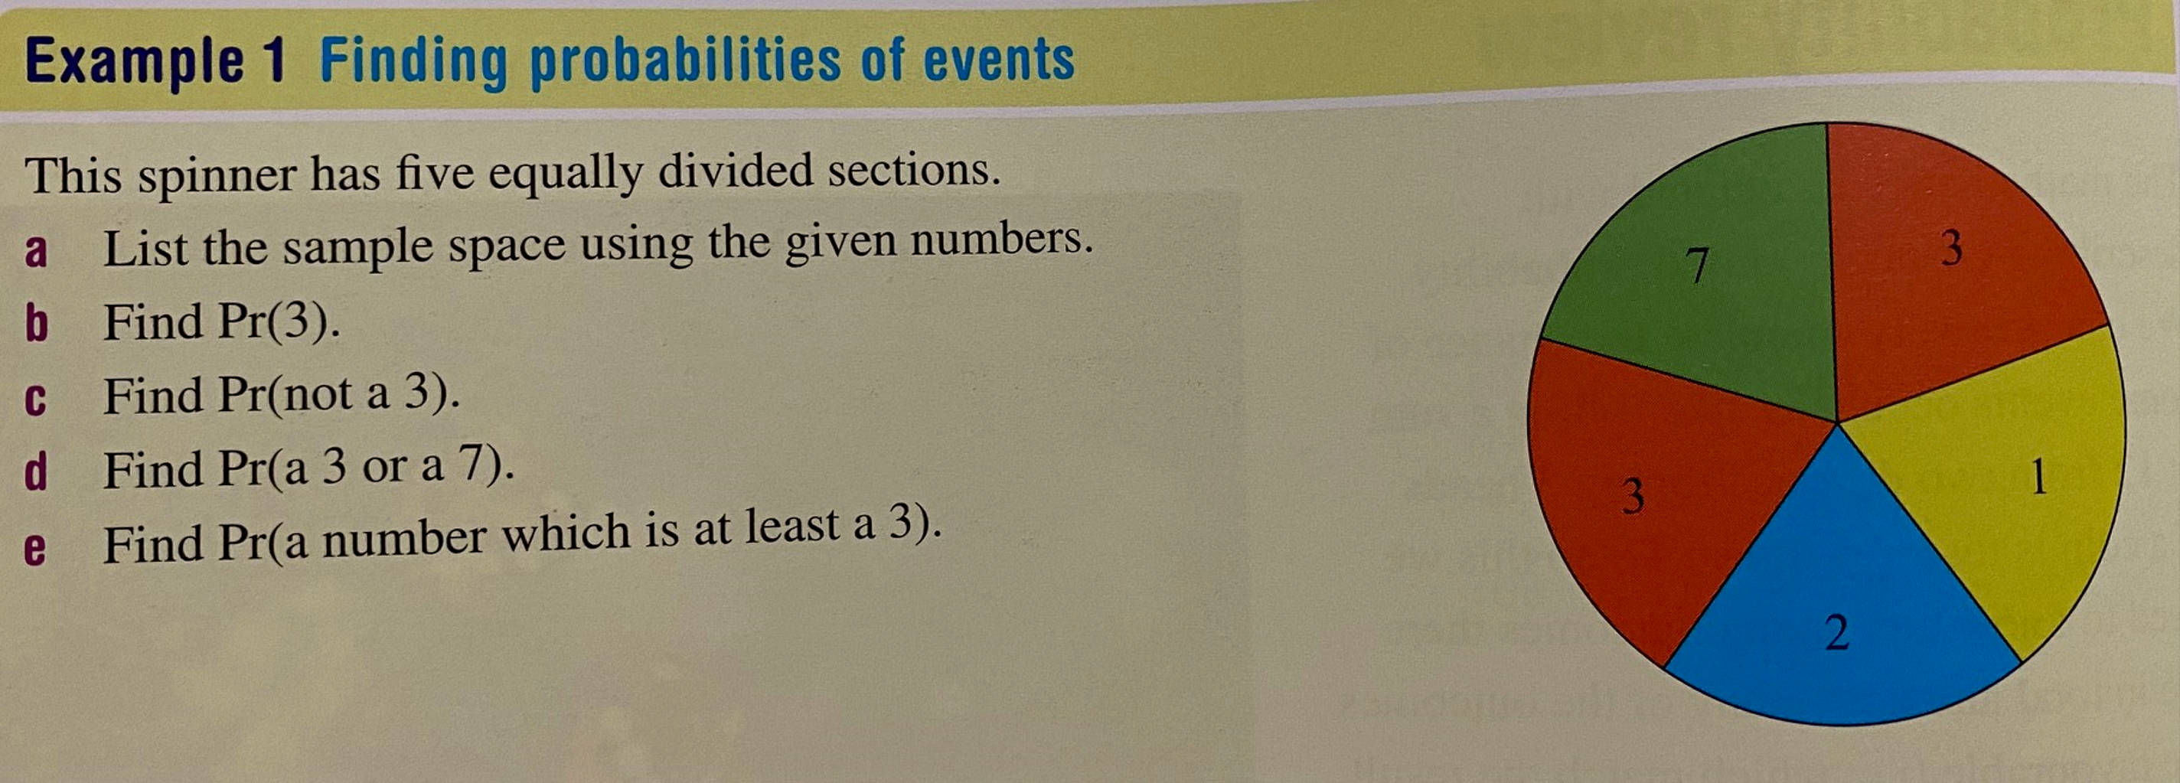

Slide 17



Ash flips a coin 100 times to test the probability of landing on tails.
Number of Flips | Number of Tails
100 | 45
$$\frac{1}{2}$$
We know this because there
are equally likely outcomes.
Theoretical Probability =
0.5
50%
An estimate of the
theoretical probability.
number of successful outcomes
45
Experimental Probability =
=
=
0.45
number of trials
100
also known as
number of times the outcome occurs
45
Relative Frequency =
=
=
0.45
‘compare’
total number of trials
100
** relative frequency is written as a decimal or percentage

Slide 18

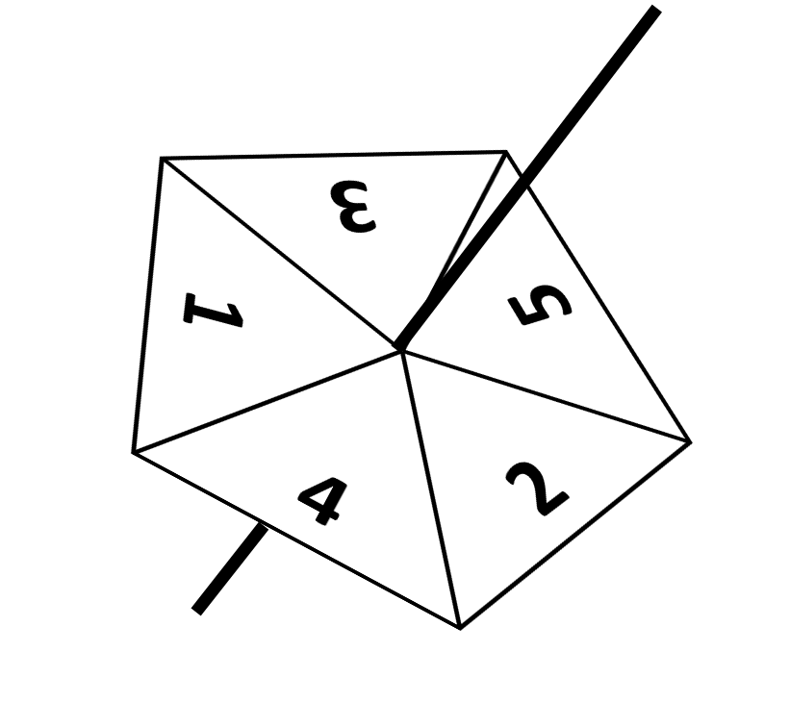

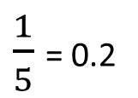
Dave & Mary run separate experiments to check if the spinner is fair.
Number of Spins | Number of 5s | Number of 4s Number of Spins
50 | 8 | 0.16
Experimental probability = 0.16
Number of Spins | Number of 5s | Number of 4s Number of Spins
100 | 22 | 0.22
Experimental probability = 0.22
$\frac{1}{5}$ = 0.2
What is the theoretical probability of landing on a 5?
Whose results give a more accurate estimate for the theoretical probability?
Is the spinner fair?
Mary’s
Probably.

